Slide 1
Tutorial
Assignment Three

Slide 2
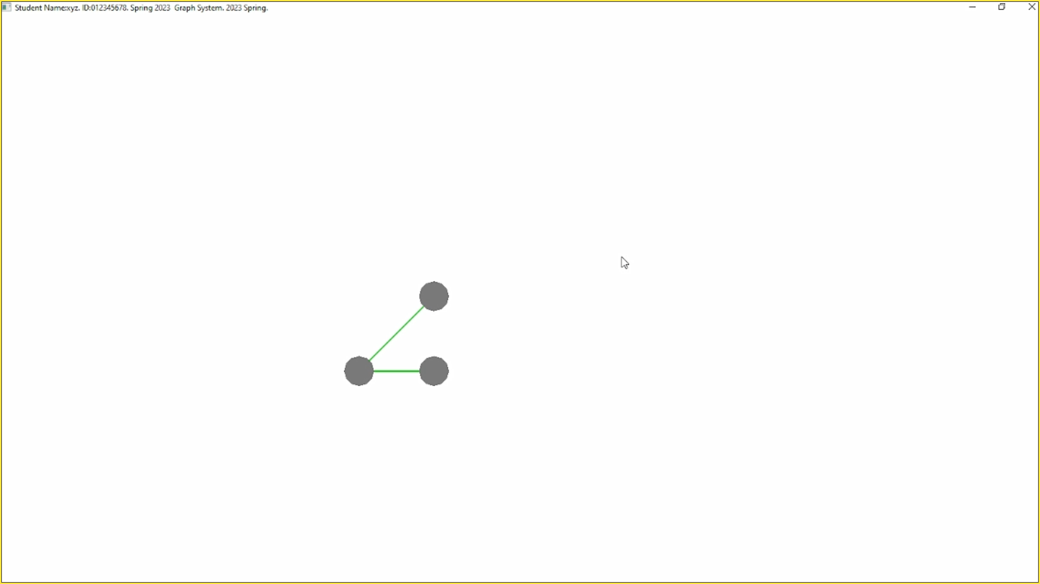
This tutorial instructs you to create the following graph in a step-by-step approach.

Slide 3
Pre-requisite
A graph consists of a set of nodes and a set of edges
An edge is attached to two nodes
You must have read the ppt about Graph Implementation
You can use arrays to represent a graph structure
ID, dynamic_ID
Mouse events
Motion move: move the mouse while one mouse button is pressed
Passive move: move the mouse without pressing any mouse button
Single click: press a mouse button and then release it at once

Slide 4
Introduction
The graph is drawn on a 2D plane
Which plane? x-y plane? y-z? x-z?
What the “depth” of the nodes?
How do you add one node?
How do you add one edge?
If you know how to add nodes and edges, you can proceed to implement node deletion and edge deletion.

Slide 5
Implementation process
Implement the following items
Initialize data members
addNode: Add a node
Return the number of nodes
Return the information of a node
addEdge: Add an edge
Return the number of edges
Return the information of an edge
Node deletion
Edge deletion
Others, e.g., create a circular net, etc.
Use the mouse to select a node or unselect a node
Interactively add an edge by using the mouse
Automatic deletion process
and other functions (if applicable)

Slide 6
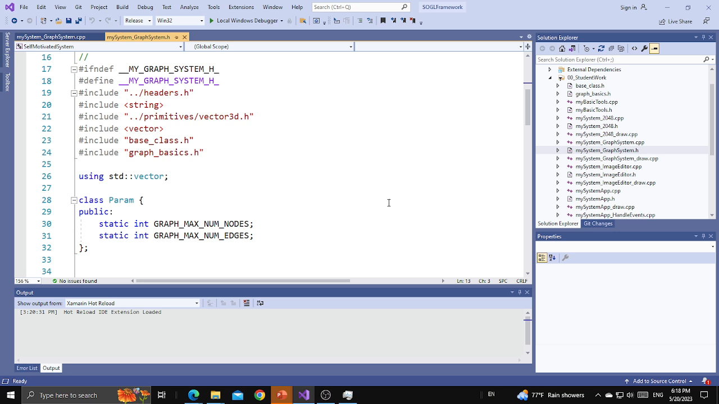
Read the .h file

Slide 7
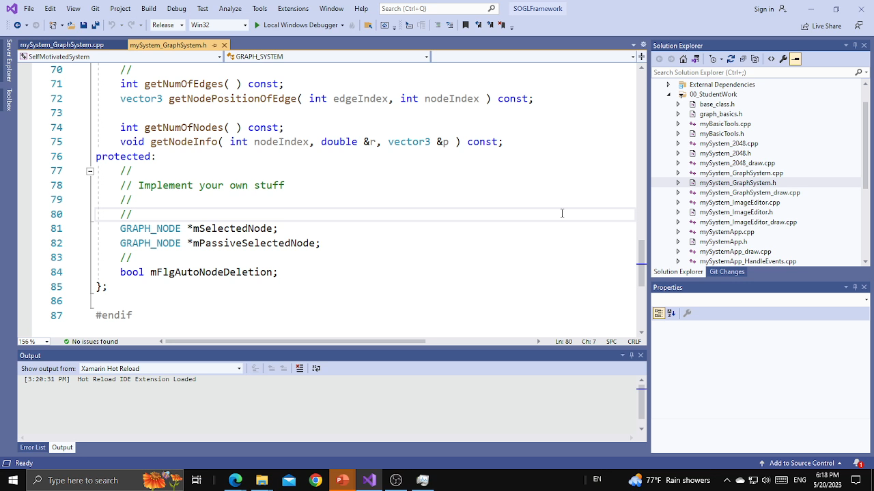
Read the .cpp file

Slide 8
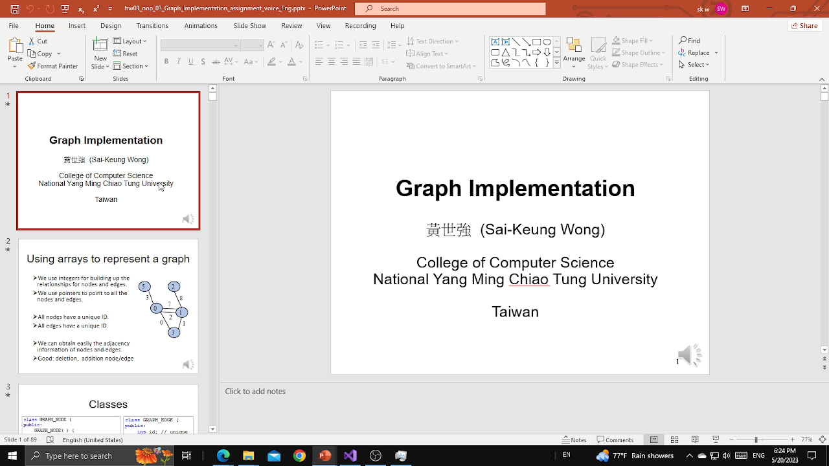
Need to add data members

Slide 9
GRAPH class
classes
class GRAPH_SYSTEM {
......
protected:
GRAPH_NODE *mNodeArr_Pool;
GRAPH_EDGE *mEdgeArr_Pool;
//
int *mActiveNodeArr;
int mCurNumOfActiveNodes;
int *mActiveEdgeArr;
int mCurNumOfActiveEdges;
//
int *mFreeNodeArr;
int *mFreeEdgeArr;
int mCurNumOfFreeNodes;
int mCurNumOfFreeEdges;
};
class GRAPH_NODE {
public:
GRAPH_NODE( ) {
r = 1.0;
p = vector3(0.0, 0.0, 0.0);
}
vector3 p; //position
double r; //radius
int id; //unique ID
// in the active index array
int dynamicID;
vector<int> edgeID;
};
class GRAPH_EDGE {
public:
int id; // unique
int dynamicID;
int nodeID[2];
};

Slide 10
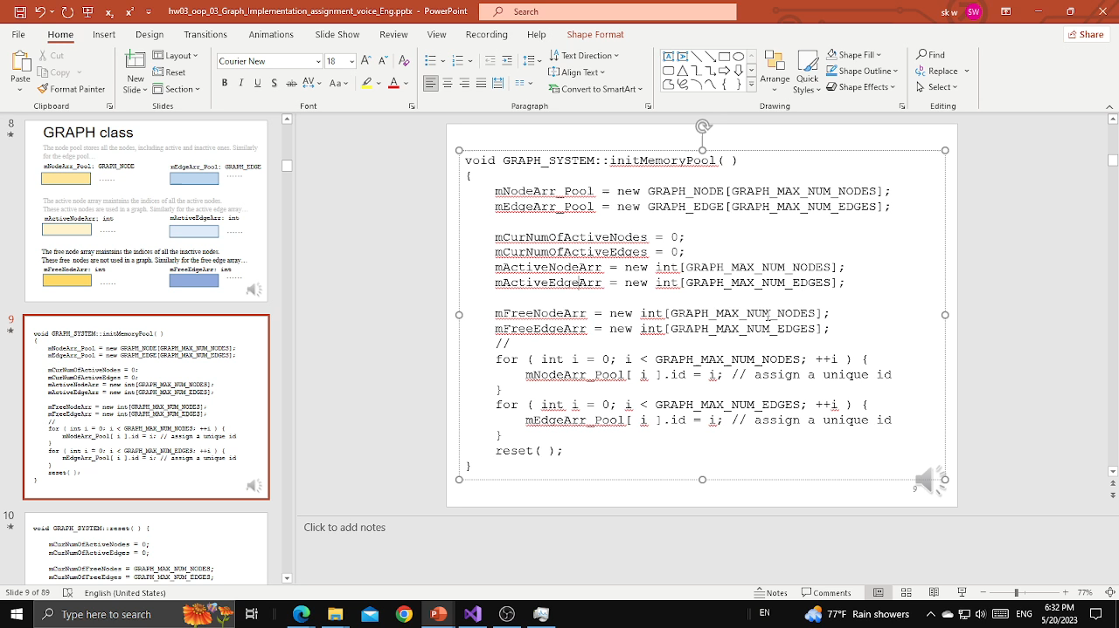
Initialize the data members, memory space

Slide 11
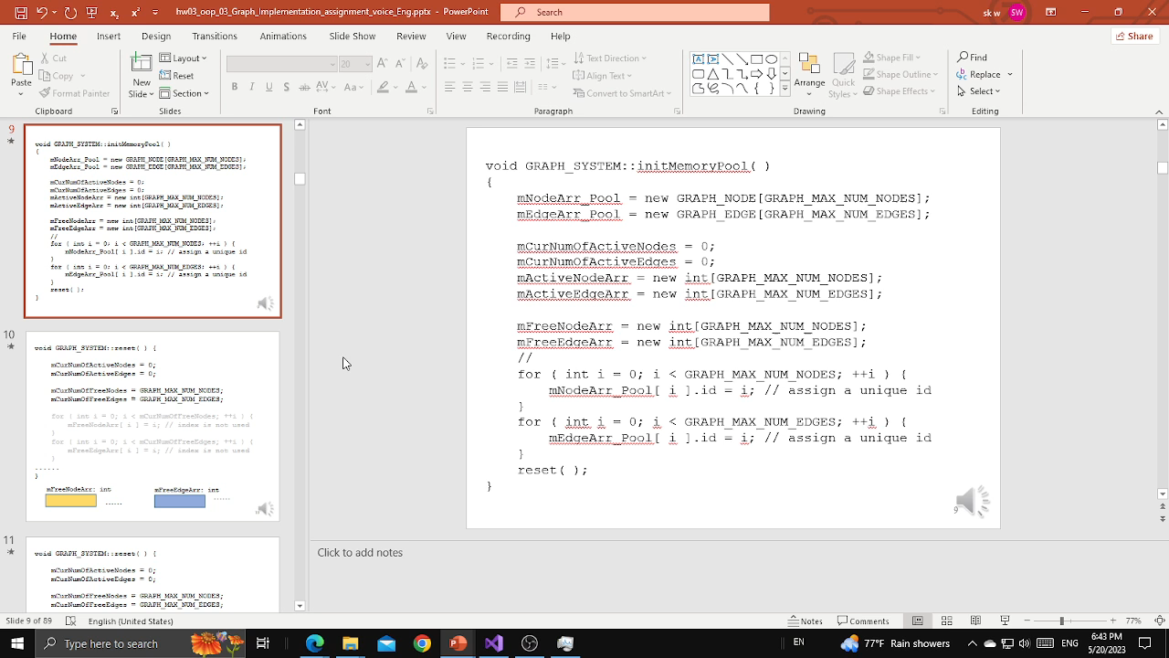
Reset the data members

Slide 12
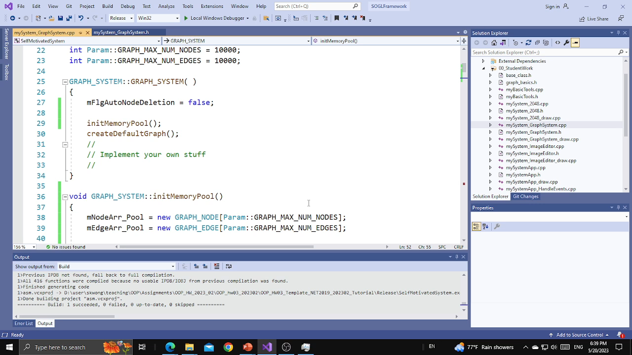
Reset the data members. How?

Slide 13
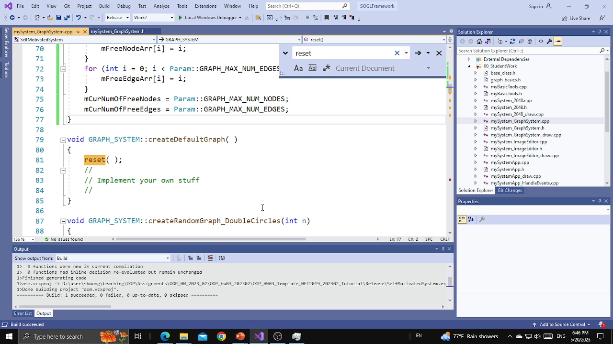
Add node - 01

Slide 14
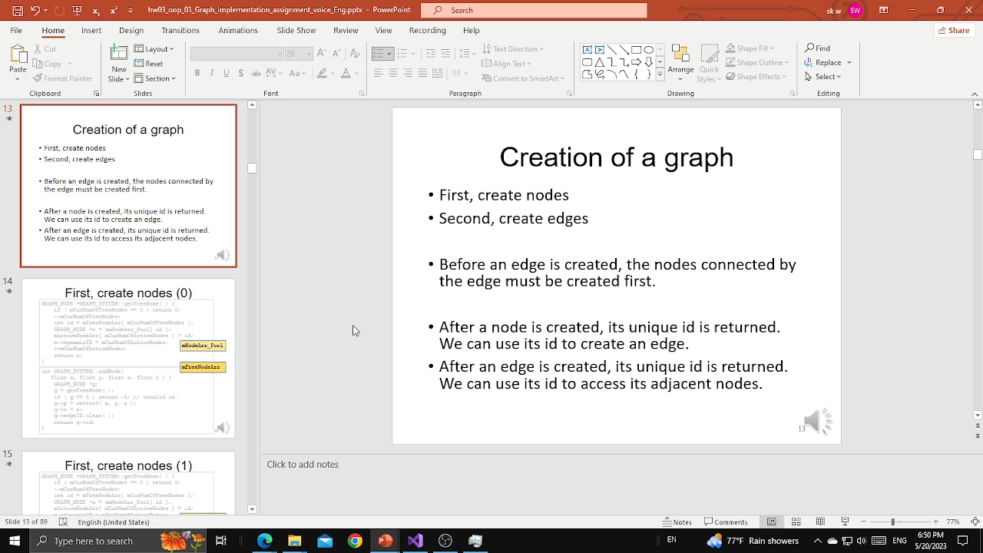
Add node - 02

Slide 15
Creation of a graph
First, create nodes
Second, create edges
Before an edge is created, the nodes connected by the edge must be created first.
After a node is created, its unique id is returned. We can use its id to create an edge.
After an edge is created, its unique id is returned. We can use its id to access its adjacent nodes.

Slide 16

Add node - 03

Slide 17
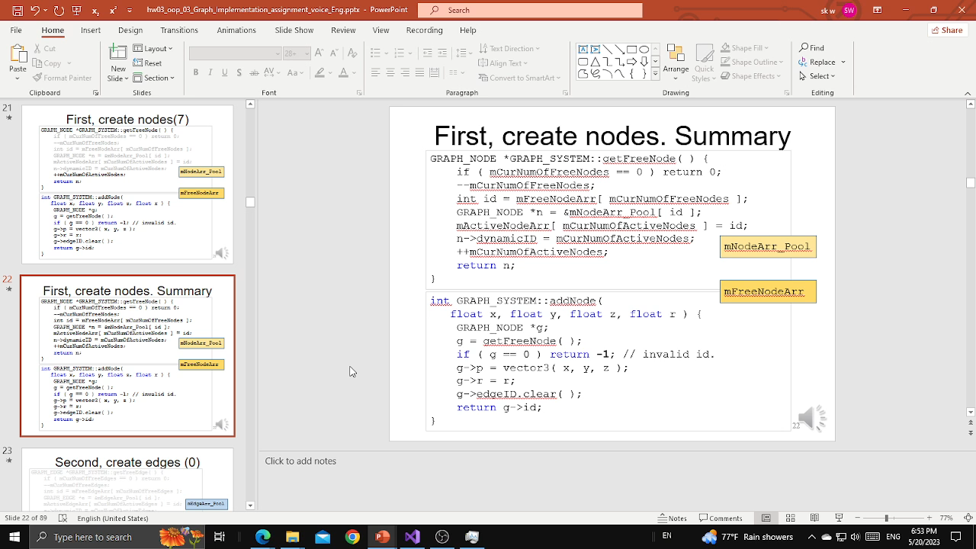
Add node - 04

Slide 18
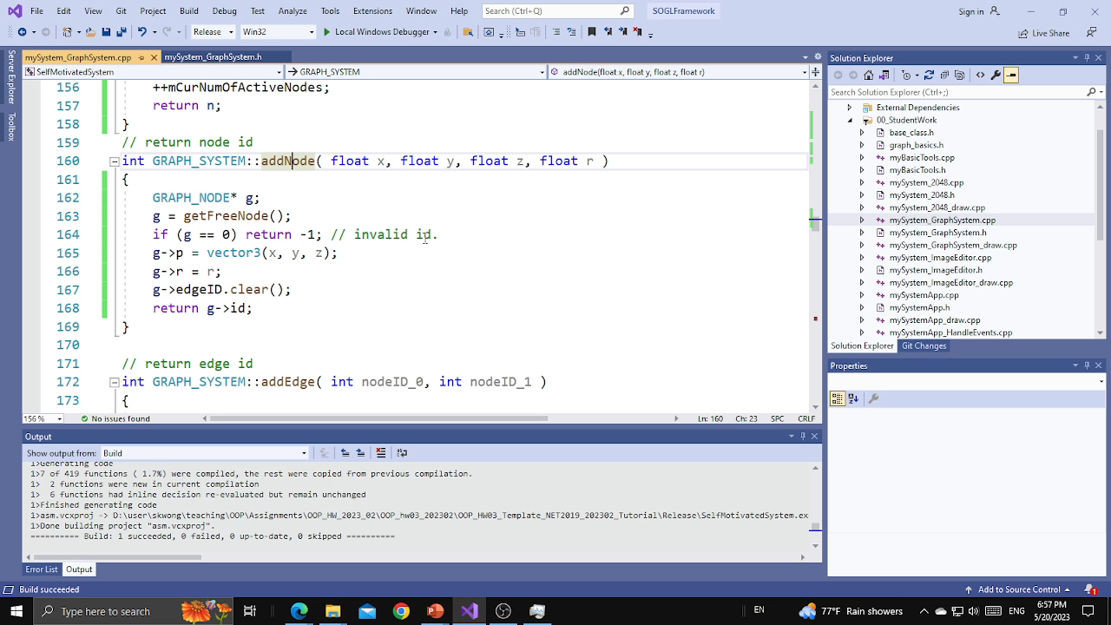
Add node, return node number and edge number

Slide 19
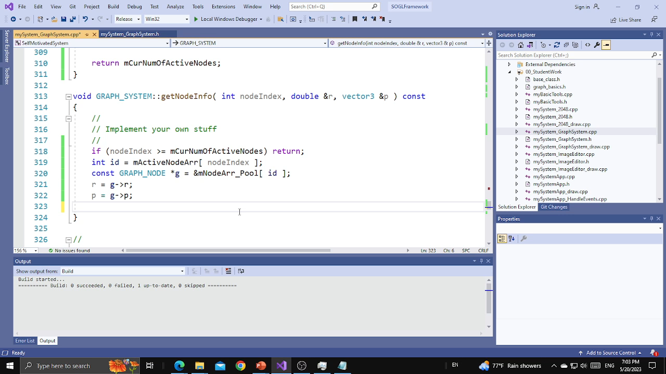
Show node(s) - 01

Slide 20
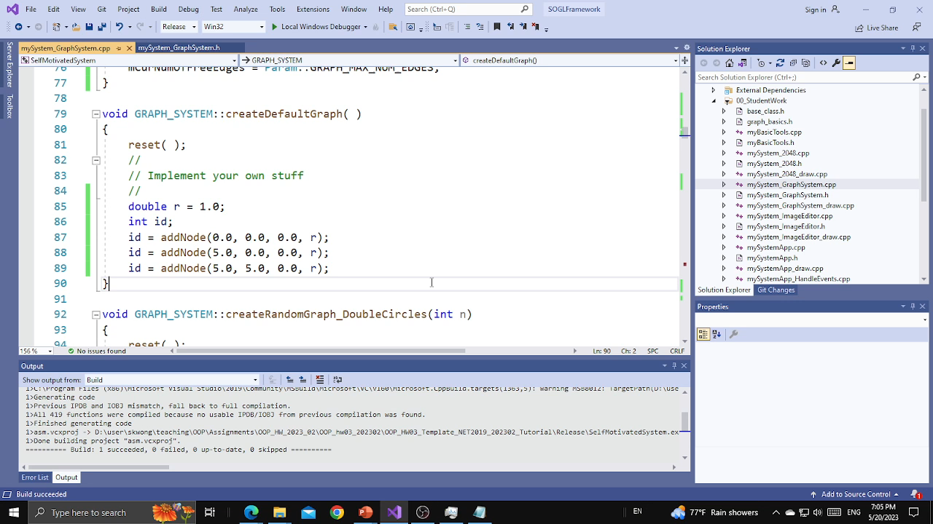
Show node(s) – 02. Which plane? x-y plane? x-z? y-z?

Slide 21
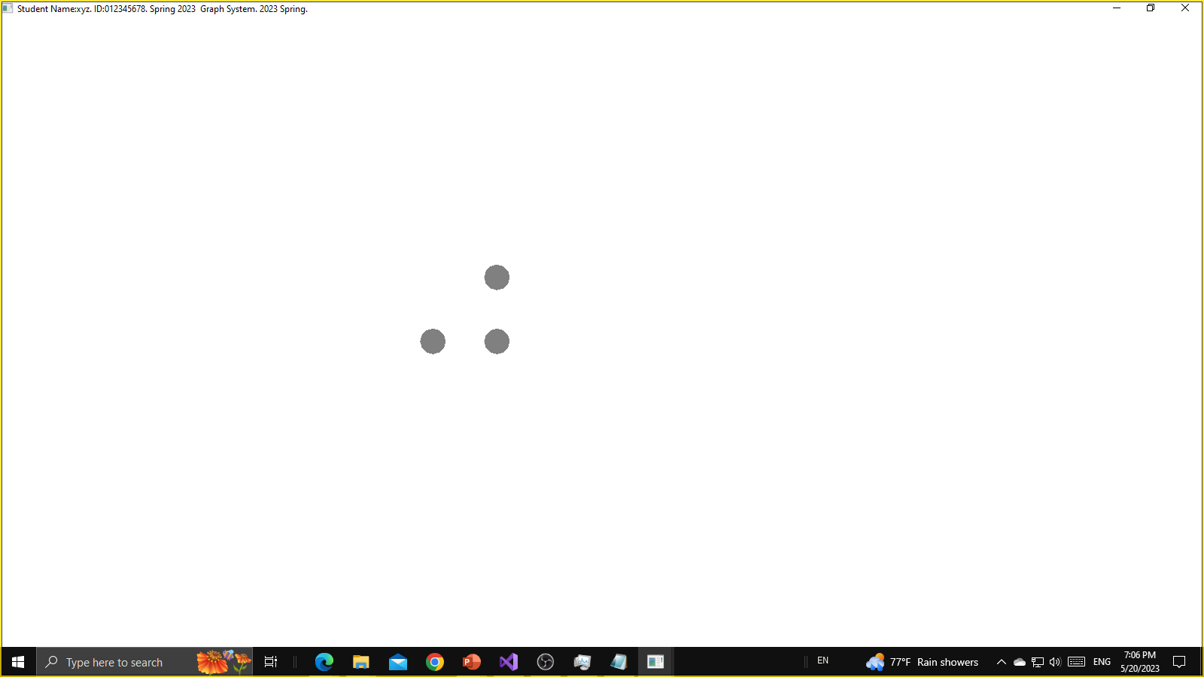
The nodes are on the x-z plane
id = addNode(0.0, 0.0, 0.0, r);
id = addNode(5.0, 0.0, 0.0, r);
id = addNode(5.0, 0.0, 5.0, r); // not x-y plane? then try x-z plane

Slide 22
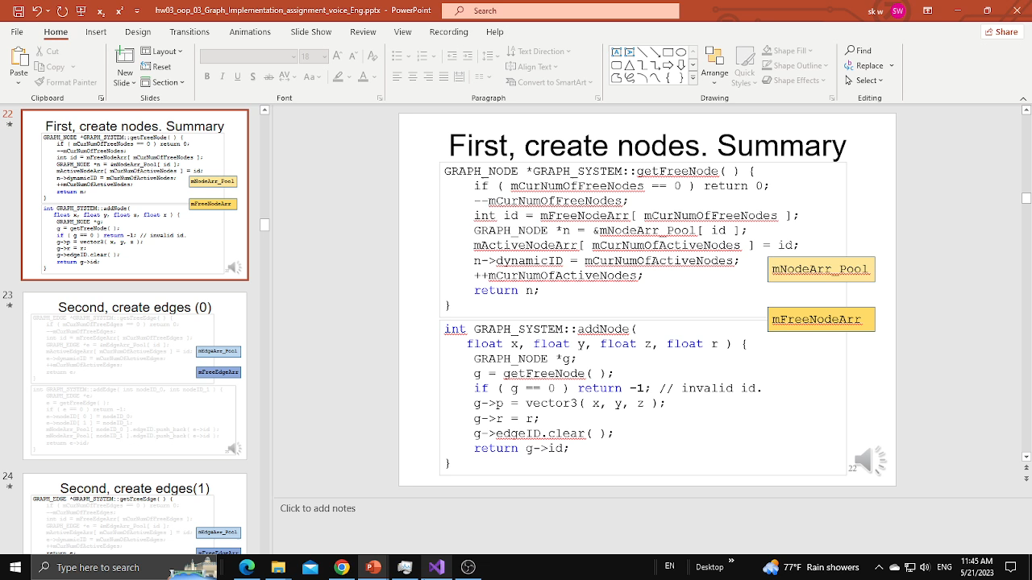
Add edge: get a free edge first before adding the edge

Slide 23
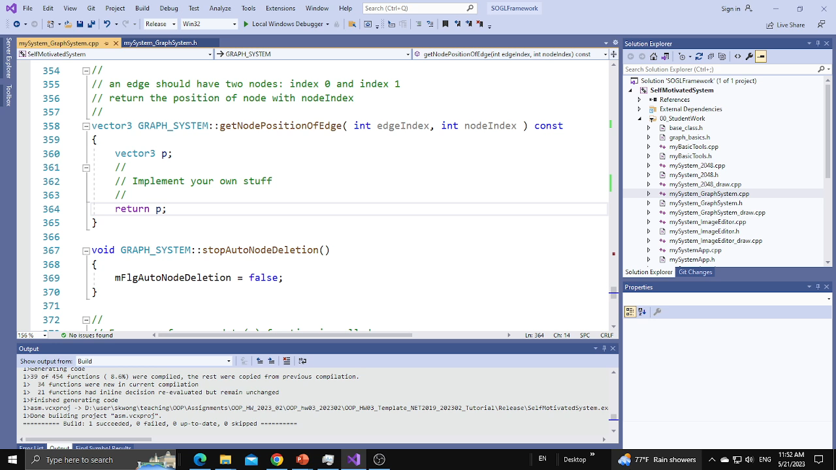
Show edge(s) – Part One

Slide 24
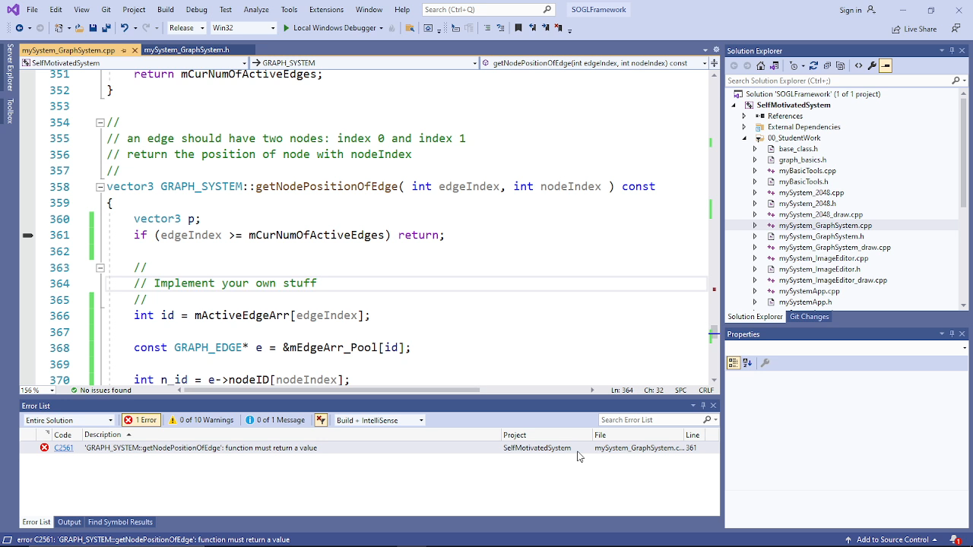
Show edge(s) – Part Two

Slide 25
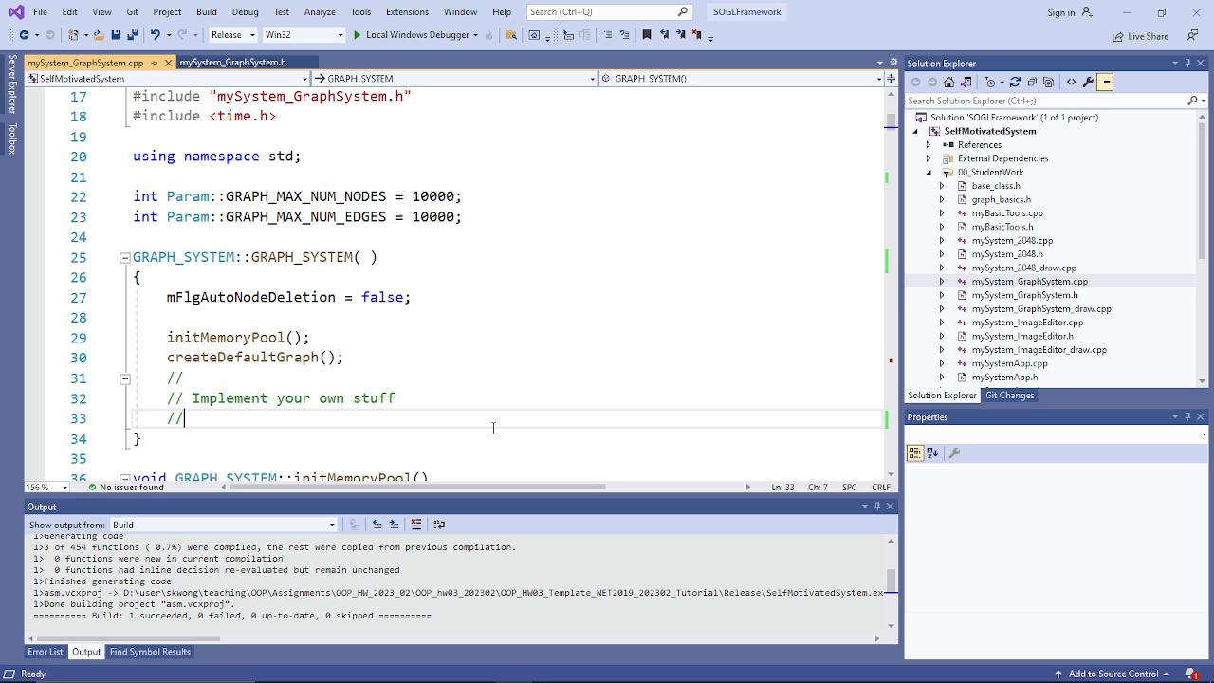
Show edge(s) – Part Three

Slide 26
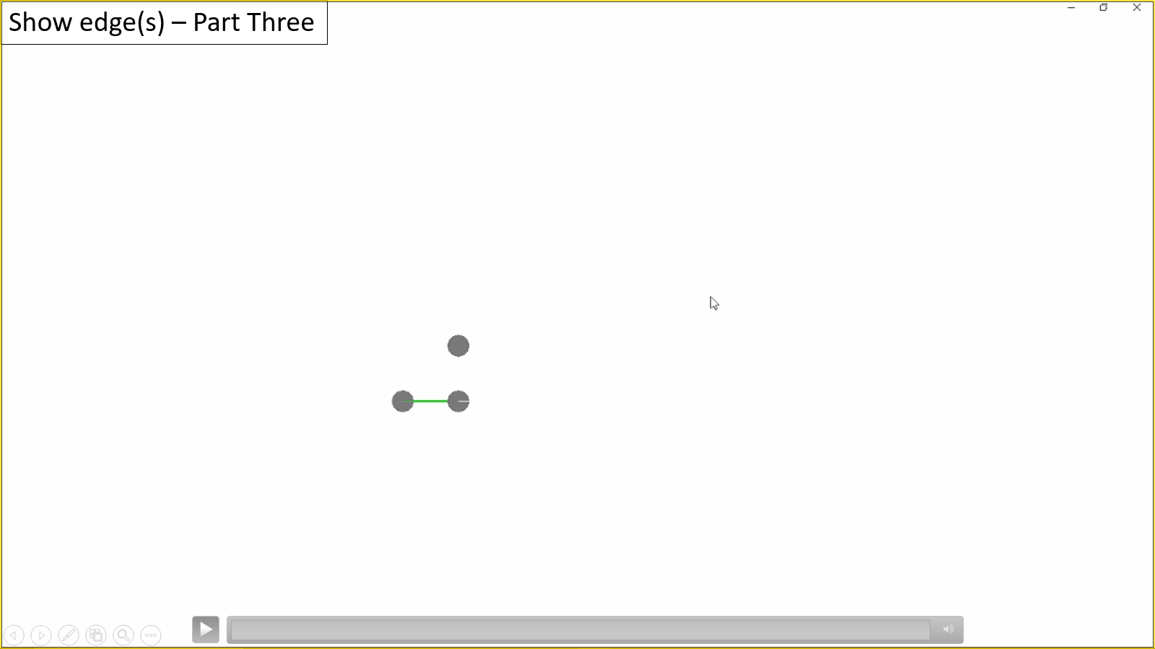
void GRAPH_SYSTEM::createDefaultGraph( )
{
reset( );
//
// Implement your own stuff
//
double r = 1.0;
int id0 = addNode(0.0, 0.0, 0.0, r);
int id1 = addNode(5.0, 0.0, 0.0, r);
int id2 = addNode(5.0, 0.0, 5.0, r);
addEdge(id0, id1);
}

Slide 27
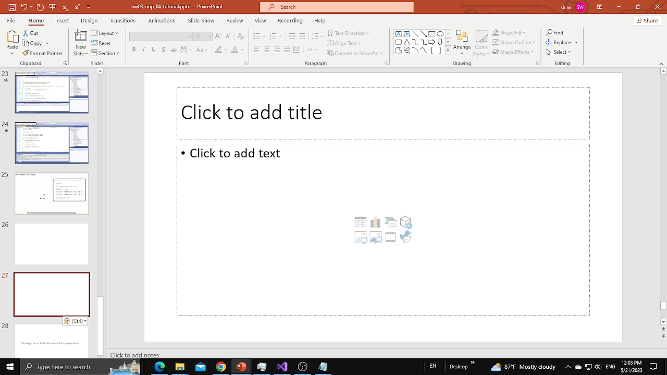
Show edge(s) – Part Four

Slide 28
Thank you for watching! Please go on to finish the rest of the assignment

